Slide 1
Leadership & Professional Ethics
Informatics Engineering,
UBAYA

Slide 2
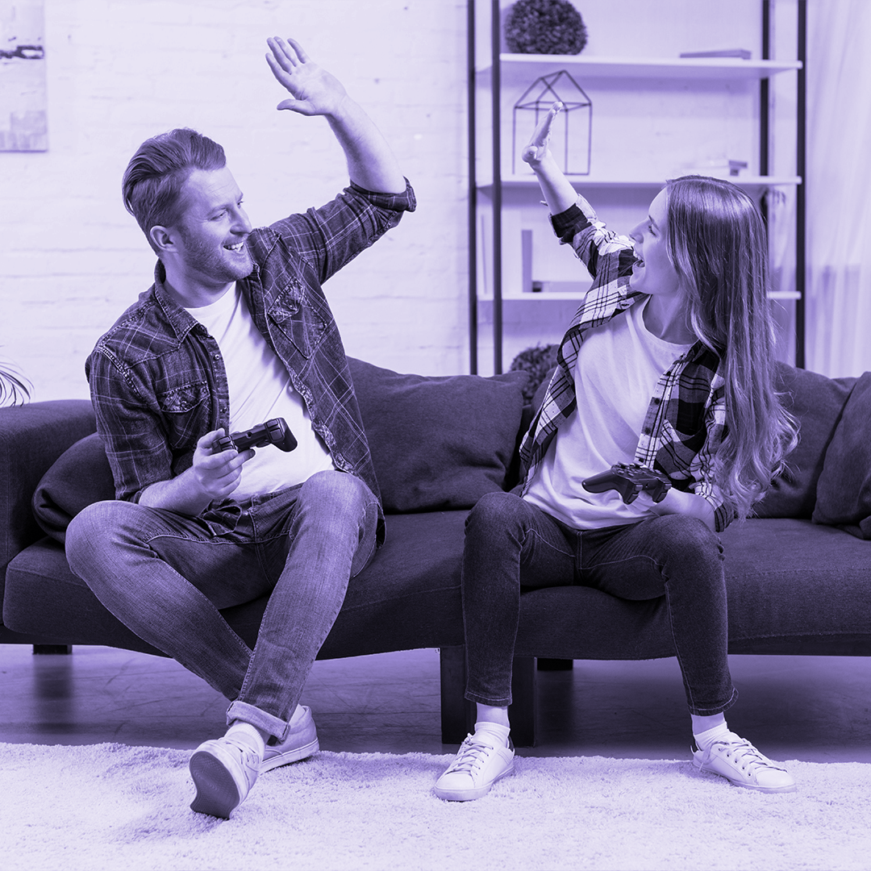
The Joy of Learning
Learn something new
The future is unpredictable

Slide 3
Program Objectives
Able to describe and communicate idea, design and solution in various workspace.
Show integrity and professional conduct which comply with the law and ethics while maintaining nationalism spirit

Slide 4
Learning Outcomes
Understand professional ethics and its application
Understand code of conduct from ACM
Understand leadership concept and its application
Have a professional character on working environment

Slide 5
Professional Ethics
Leadership
Posses professional attitude and ethics
Reach further result due to better employment of human resource

Slide 6

Contract
Fail on this subject for any violation of university’s ethics including plagiarism

Slide 7
Marking
UTS / UAS
100% Assignment

Slide 8
Project Teamwork Practice – UAS
Student Employee at Ubaya
Committee of an event or student group in Ubaya
Compete in a competition (Group) – Special
It is compulsory to participate in 2 activity from 2 different categories, except for the Special Categories you can pick 2 activity from the same category.
Research / community service colab with IT Lecturer – Special
Lecturer’s Assistant at IT Dept, Ubaya

Slide 9
Lomba
Compete in a Competition in a group, mentored by 1 lecturer from IT Dept.
For Competition which comply with your program knowledge (IF, SIB, MM), maximum 75 poin (National) or 85 poin (International) for selection phase. Additional mark would be given according to the achievement (Finalist/ Runner Up/ Winner, etc.)
For Competition which comply with your program knowledge (IF, SIB, MM), maximum 65 poin (National) or 75 poin (International) for selection phase. Additional mark would be given according to the achievement (Finalist/ Runner Up/ Winner, etc.)

Slide 10

Competition
Upload poster, scan certificate, photo of the medal/trophy and other important photo during competition, and the product (essay/photo/program/proposal, etc.) to this folder : https://ubaya.id/DriveLomba
Fill the next form for the details : https://ubaya.id/DataLomba

Slide 11

Research / Community Service
Upload assignment letter, photo and other documents to this folder : https://ubaya.id/DrivePPM
Fill the next form for the details: https://ubaya.id/DataPPM

Slide 12
A little experiment
5 students join breakout room for 5 mins.
Others can have 5 mins break

Slide 13
A little experiment
You have some fund to buy only 1 item.
Which item would you chose

Slide 14
Key Aspect
In every part of your professional live you will always need to deal with other people, your client, your leader, your colleague, your worker, etc.
Communication

Slide 15
Communication Skill
2 Ways
Not always inline with the hard skill

Slide 16
Communication Skills
C = Q * P * R
Aturan 1 2 3
Notes:
Communication
Question
Praise
Reaction
1 talk 2 listen 3 respons + feedback

Slide 17
When you speak
Logical – do your homework
Reasonable argument
Not jumping to conclusion
Consistent
Simple, not throwing and overusing jargons
Calm
Notes:
Mengapa semakin banyak marketing yang direkrut dari bidang Teknik ? Karena menguasai produk dan isi pembicaraannya meyakinkan.

Slide 18
People love to hear story
Theme
Conflict
Sympathy
Resolution

Slide 19
If you petrified
Never bully yourself by put down your own capacity, or say something bad about yourself
Be humble and show your imperfect side can help to draw some sympathy.
Do your homework, be prepared, always remind yourself that you know this topic more, this is your area
Notes:
Manusia pada umumnya merasa terancam pada orang lain yang terlalu sempurna kecuali jika orang itu adalah idolanya atau seorang yang sangat dihormatinya. Sebuah tanda ketidaksempurnaan akan membuat orang lain lebih relax.

Slide 20
Make other feel good
Understand Yourself
Understand the Other Side
Be Confident
Adapt

Slide 21

Discuss
Create do and don’t list for communication using email and messenger with somebody with an important position which you need to have his or her approval.
Give an example

Slide 22
Johari Window
Able | clever | friendly | introverted | observant | religious | silly
accepting | complex | giving | kind | organized | responsive | smart
adaptable | confident | happy | knowledgeable | patient | searching | spontaneous
bold | dependable | helpful | logical | powerful | self-assertive | sympathetic
brave | dignified | idealistic | loving | proud | self-conscious | tense
calm | empathetic | independent | mature | quiet | sensible | trustworthy
caring | energetic | ingenious | modest | reflective | sentimental | warm
cheerful | extroverted | intelligent | nervous | relaxed | shy | wise
 |  |  |  |  |  | witty
Accept

Slide 23
Johari Window
I Know
I Don’t Know
Open
Blind Spot
Others Know
Others
Don’t Know
Hidden
Unknown

Slide 24
Gestur give more impact
What people says sometimes are not what they feel
Look around to gaze the situation
Women are more perceptive than men (refer to as intuition) 14 – 16 areas in female’s brain for behavior evaluation, compare to 4 – 6 areas of male’s brain -> the nature of a mother
Notes:
Pria terkadang kurang memperhatikan tanda2, karena itu seringkali disebutkan wanita punya intuisi, sebenarnya wanita hanya lebih memperhatikan gejala dan tanda di sekitarnya (natur ibu yang harus memperhatikan anaknya agar tahu apa yg dirasakan bayinya yg belum bisa berkomunikasi).

Slide 25
Read gesture in clusters
1
Read gesture in context
2
When words and body language are in conflicts, forget what is said
3
Notes:
Jangan hanya melihat 1 gejala lalu menyimpulkan, tetapi lihat sekelompok gejala.

Slide 26
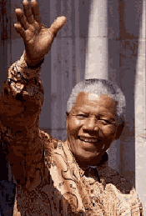
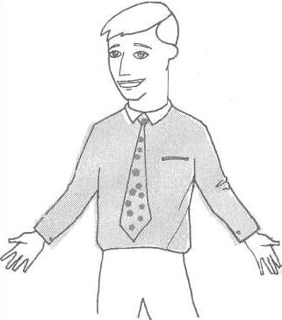
The power of the hands
Open palm is a sign of openness and honesty

Slide 27
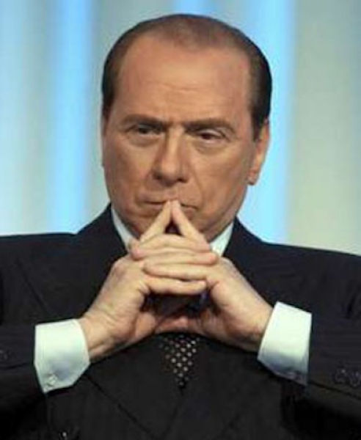
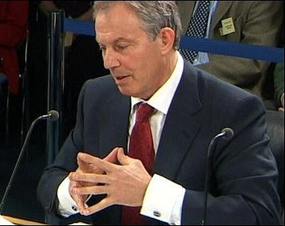
The power of the hands
The steeple posture : everything is under control

Slide 28
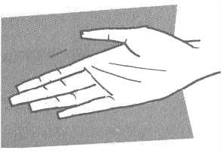
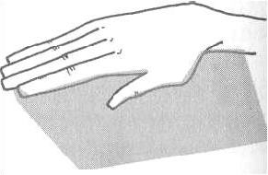
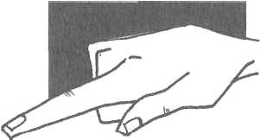
The power of the hands
Non threatening
Authority
Do it or ……

Slide 29
The power of the hands : Handshake
Not to soft like a dead fish
Not to strong like a bone crusher
For a leader, it is better to stand at the left side to show the upper hand side of authority
Avoid using both hands, touching and hugging unless you are very close with the subjects

Slide 30
Zygomatic major and orbicularis oculi muscles
A genuine smile can produce a positive reaction
Smiling is contagious
Recognize the fake smile from the genuine one
Notes:
Senyum original bukan hanya mulut yang tersenyum, tetapi sudut mulut dan sudut mata juga ikut tertarik, istilahnya mata ikut tersenyum.

Slide 31
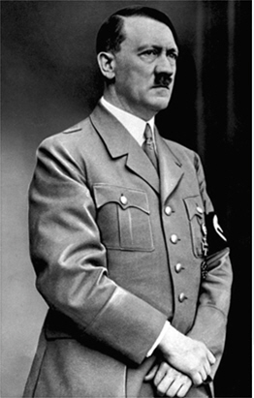
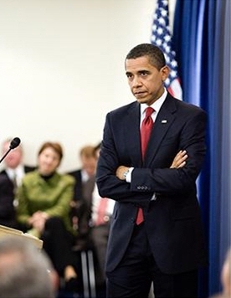
Barrier
Arm Barrier
Other barriers : partial arms, using bag, flowers, or a coffee cup

Slide 32
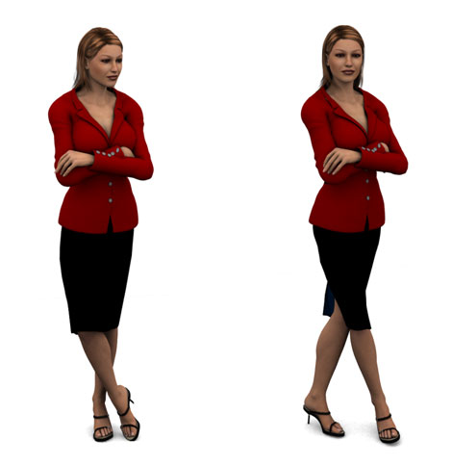
Barrier
Leg barrier

Slide 33
Barrier
Note :
Touch the subject’s elbow for as short as two or three seconds (or hands) sometimes can overcome the barriers

Slide 34
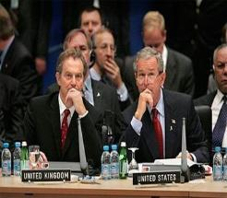
Mirroring
Notes:
Ada bagian dari otak yg terkadang secara otomatis meniru perilaku di sekitarnya. Dan manusia pada dasarnya senang menemukan orang yang mirip dengan dirinya, maka salah satu cara mengakrabkan diri adalah mirroring.

Slide 35
How to tell a lie
Normal people are uncomfortable when they tell a lie
Eye movement (based on the sensory of brain)
Notes:
Ketidaknyamanan terkadang mempengaruhi kelenjar keringat, kulit dan syaraf tertentu yang seringkali menimbulkan rasa gatal, di kepala, di wajah, dll. Kebohongan juga dapat dideteksi saat mata menghindari bertatapan.

Slide 36
Smoking
Outward signals of inner conflicts
Incapability to handle problems
Social and teamwork problems
Nicotine in the blood can increase stress level

